Slide 1
Global Change Ecology
João Maria Domingos Lourenço Marreiros Loureiro,
Kandl Matyáš,
Casian Romana,
Kripa Thapa,
Phone Thant Kyaw

Slide 2
The Big Five
Previously in the series…

Slide 3
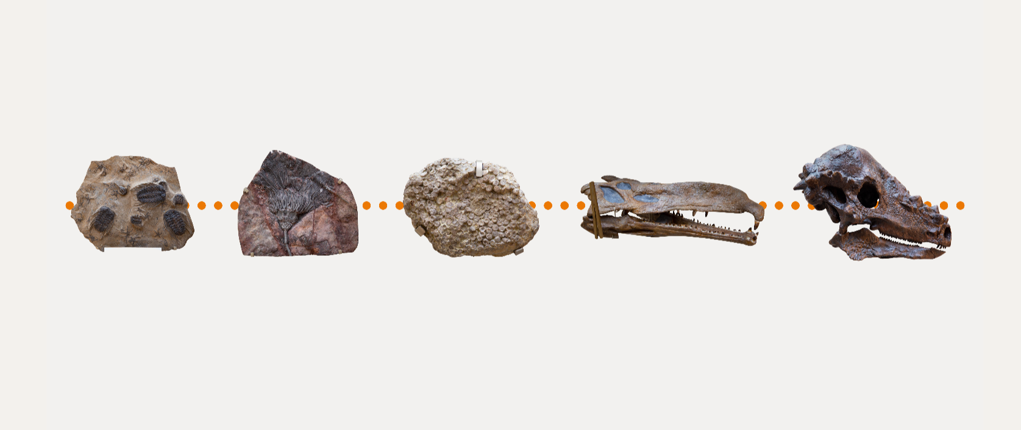
Earth’s five mass extinctions | Oxford University Museum of Natural History

Slide 4
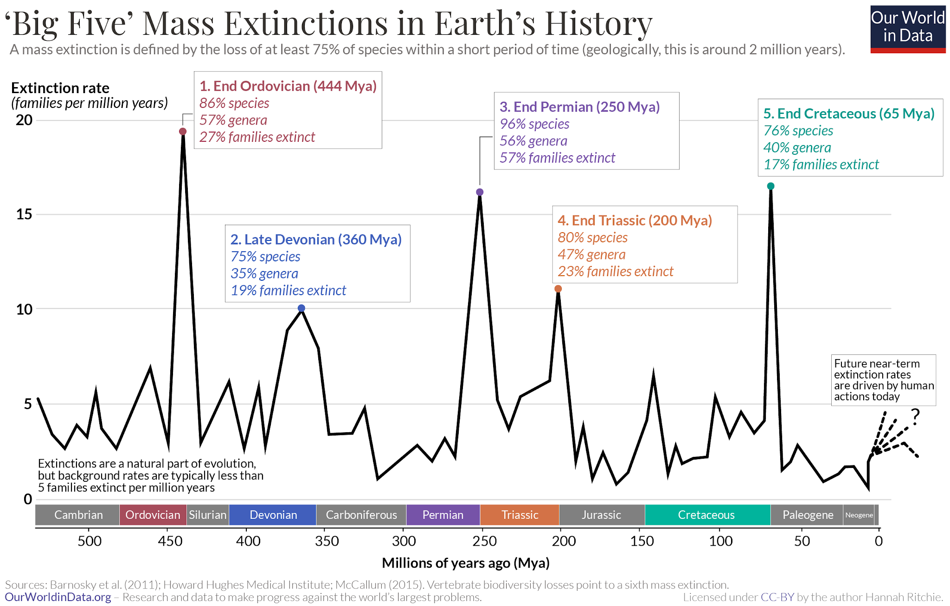
The Big Five
https://en.wikipedia.org/wiki/Extinction_event
Notes:
The "Big Five" Events: Over the last 500 million years, Earth has suffered five catastrophic wipeouts. As you can see on the graph, these are the End Ordovician (86% of species lost), Late Devonian (75%), End Permian (96%), End Triassic (80%), and End Cretaceous (76%).
The Shared Metric: While background extinction is normal, these five historical spikes share one defining trait: each wiped out at least 75% of all global species.
The Modern Spike: Now look at the far right (the zero mark). That dotted line with a question mark represents the current, human-driven crisis.
The Core Question: Are we officially entering a 6th mass extinction?
How We Measure It: Because we are actively in the middle of this event, we can't just count the total species lost yet. Instead, we must measure the speed of current extinctions against the normal, natural baseline.

Slide 5
How to define an extinction?

Slide 6
Ceballos defines a mass extinction by how fast species are currently disappearing relative to geological background levels.
Wiens & Saban defines a mass extinction by how many total species are lost (requiring 75% total loss)
Notes:
Ceballos means Modern extinction rate compared to BGER

Slide 7
Measuring Background Extinction Rate (BGER)
What is the background extinction rate?
It represents the natural pace at which species disappear over geological without the impact of humans.
How is it measured?
Using the Phanerozoic marine invertebrate fossil record.
charting the stratigraphic ranges of thousands of mammal species
How much is the BGER?
0.1-1E/MSY
1.8~ rounded up to 2E/MSY
1 species extinctions per 10,000 species per 100 years
Notes:
Scientists charted the appearance and disappearance of fossilized mammal families and genera over millions of years
and he (Barnosky 2011) used paleontological databases, subfossil remains, and historical records
Stratigraphic - mapping where sediments (fossils) occur in soil to determine the age of it
We will get into why this E/MSY data is higher than previous studies in a little bit
Now that we know what BGER is, we will have to look at this boring but easy to understand table to understand the modern extinction rate

Slide 8
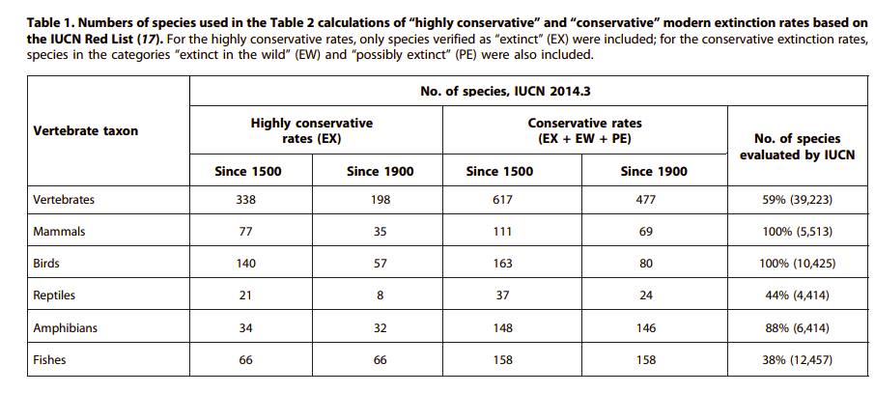
Notes:
Table 1 was used to calculate the modern extinction rates in table 2
It uses data from the International Union for Conservation of Nature (IUCN)

Slide 9
Conservative VS Highly Conservative
Highly conservative:
Only considering the officially extinct species from the Red list.
Conservative:
Consider the extinct species, extinct in the wild, possibly extinct from the Red list.

Slide 10
338-198=140 species went extinct in 400 years for the highly conservative scenario.
617-338=279 extra species became extinct in the wild or possibly extinct in the conservative scenario.
Notes:
For the highly conservative rate (EX) since the 1500s so in the last 514 years 338 vertebrates went extinct so that would be: 77 mammals + 140 birds + 21 reptiles +...
From 1900 to 2014, in 114 years, 198 vertebrates went extinct
Key Takeaway from Table 1: The vast majority of documented extinctions occurred after 1900. 146 out of 148 amphibian extinctions recorded since 1500 happened after 1900. So there were only 2 extinctions in 400 years (1500-1900).
Conclusion: Under the 2 E/MSY background rate, 9 vertebrate extinctions would have been expected since 1900; but, under the conservative rate, 468 more vertebrates have gone extinct so the background rate had not persisted across all vertebrates.

Slide 11
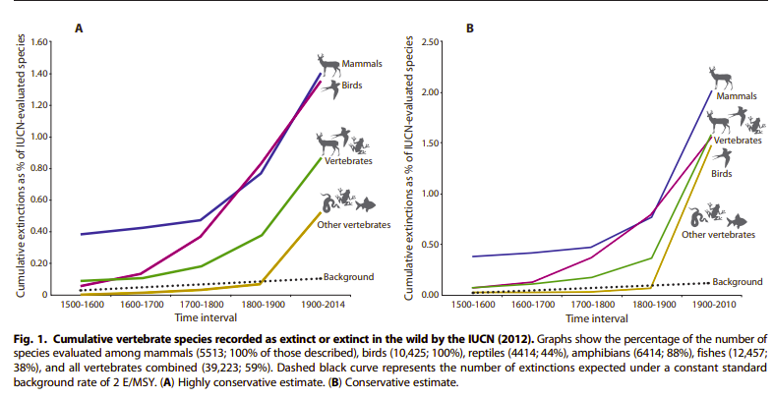
Notes:
This graph is a visual representation of table 1 to show that there has been an extinction spike starting from the 1900s as well as to show that modern extinction rate is much higher than BGER relative to time.

Slide 12
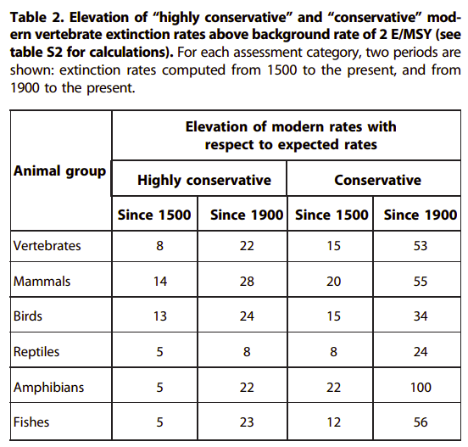
Table 2 translates the raw numbers from Table 1 into an elevation multiplier, showing how many times modern extinction rates exceed the benchmark background rate of 2 E/MSY.

Slide 13
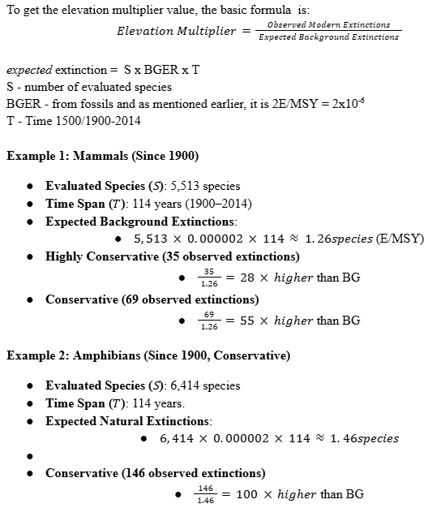
“Our analysis shows that current extinction rates vastly exceed natural average background rates, even when (i) the background rate is considered to be double previous estimates and when (ii) data on modern vertebrate extinctions are treated in the most conservative plausible way.”
Notes:
As mentioned on the first slide, the background rate was rounded up to 2E/MSY, double the previous estimate and this is to get the lowest bound data possible to disprove “threat inflation”.

Slide 14
Human Impact On Species And Biodiversity Loss

Slide 15
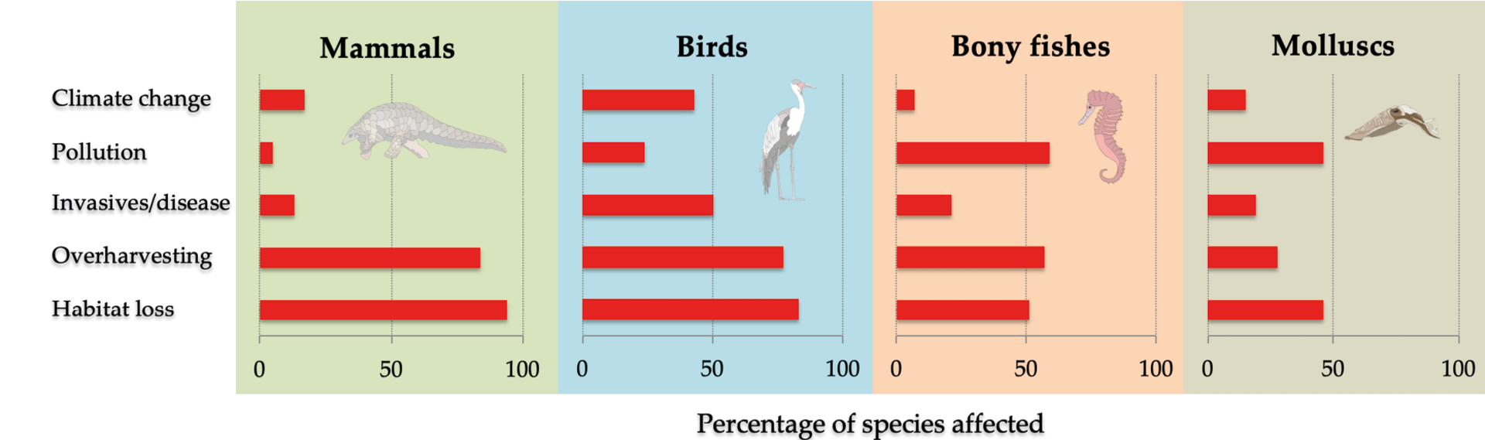

Slide 16
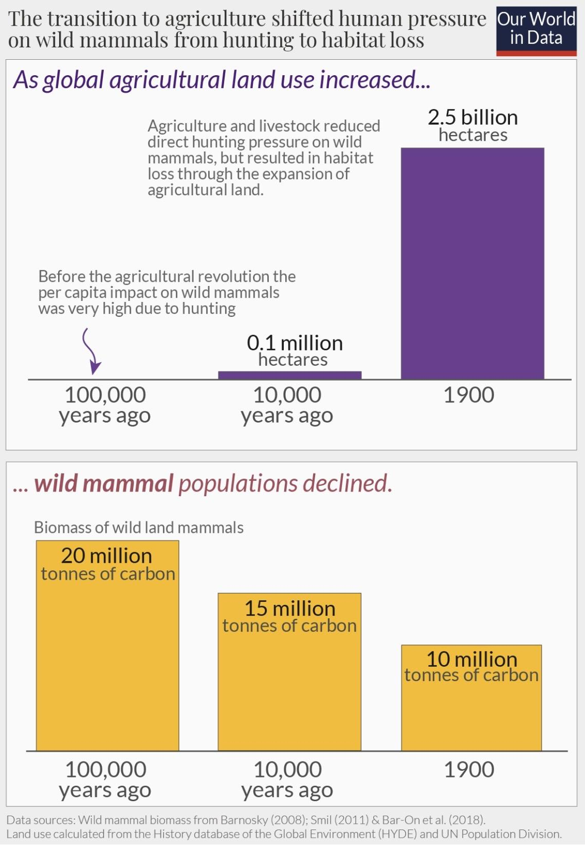
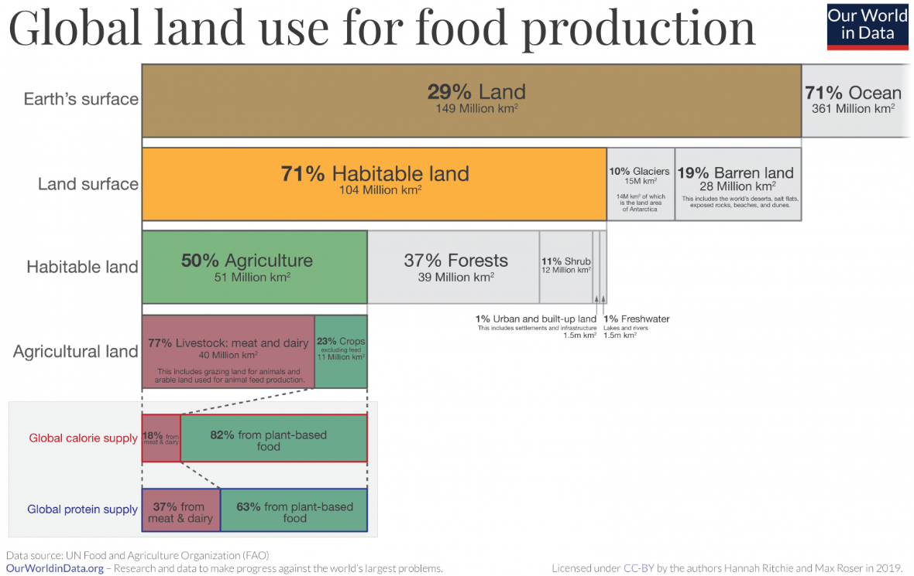
Habitat loss and fragmentation endanger 85% of species on the IUCN’s Red List.
Agriculture is a big factor, as forests, meadows and wetlands are cleared for grazing and fields.

Slide 17
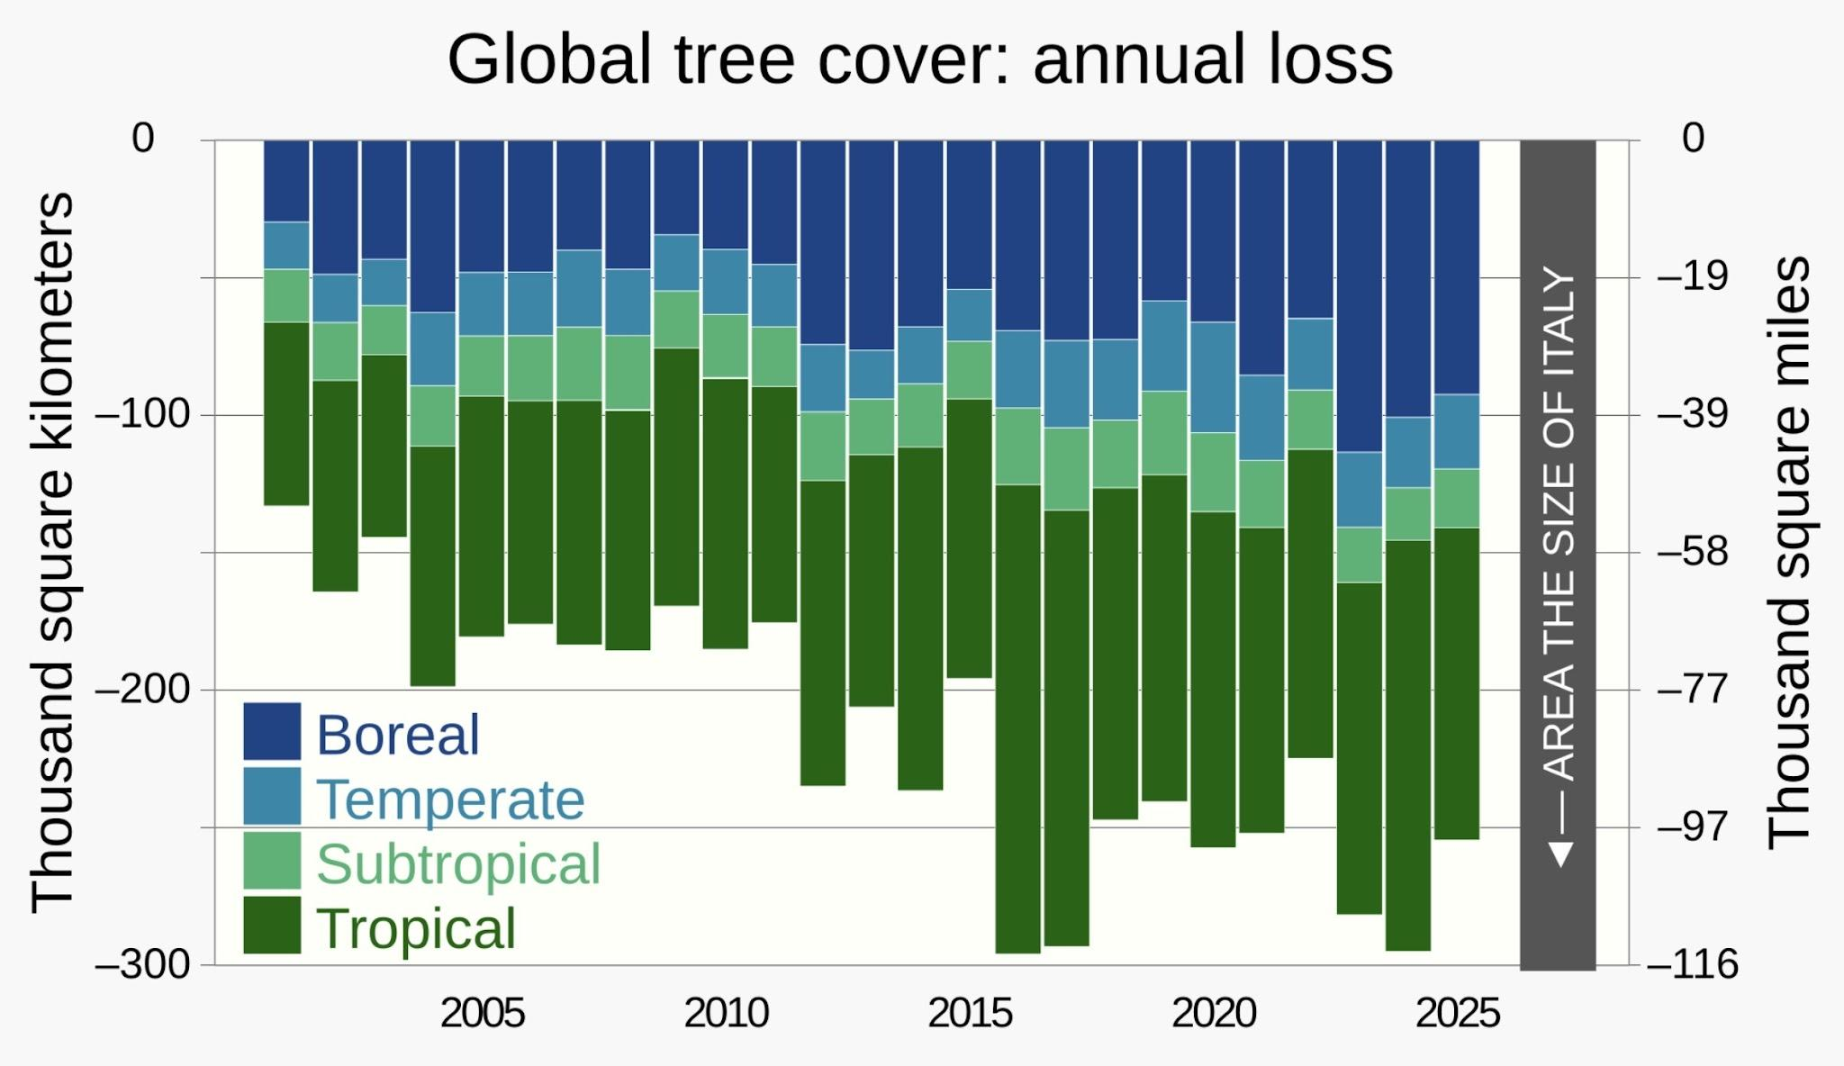
Deforestation

Slide 18
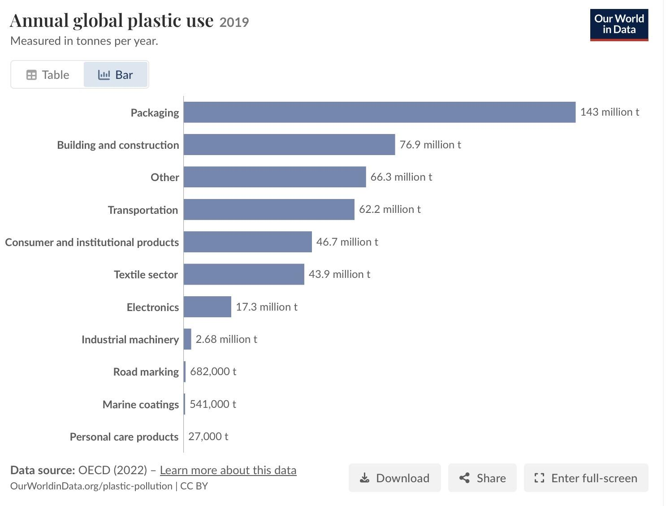
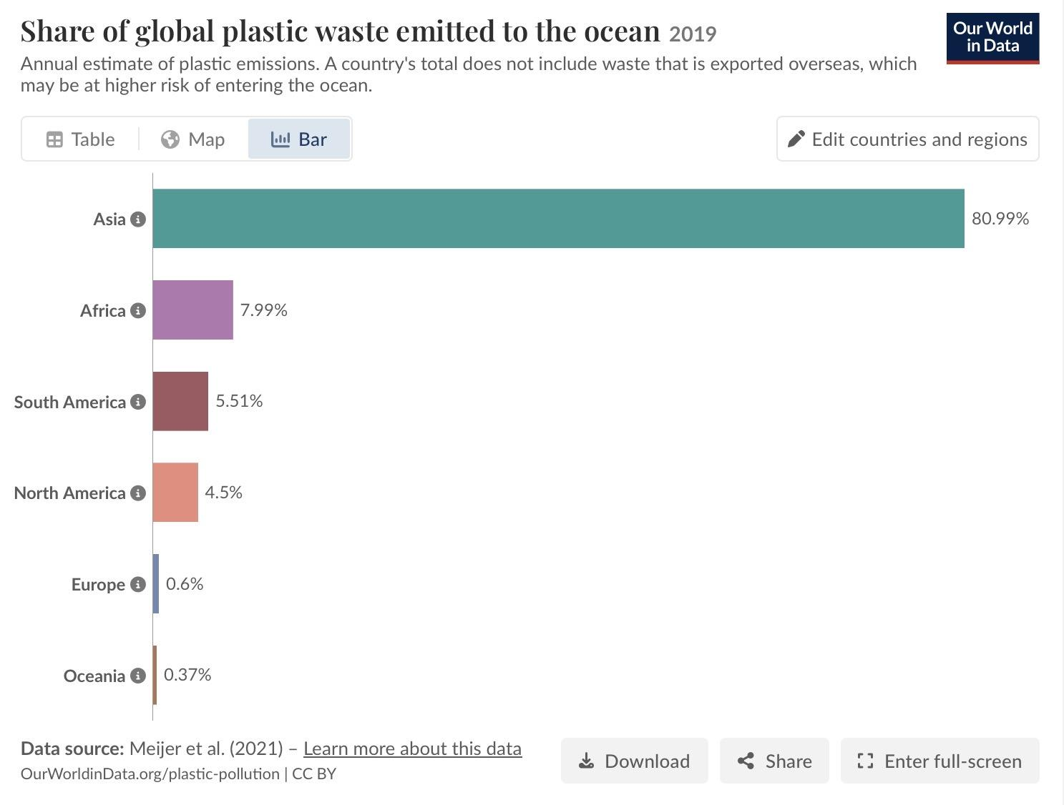
Pollution

Slide 19
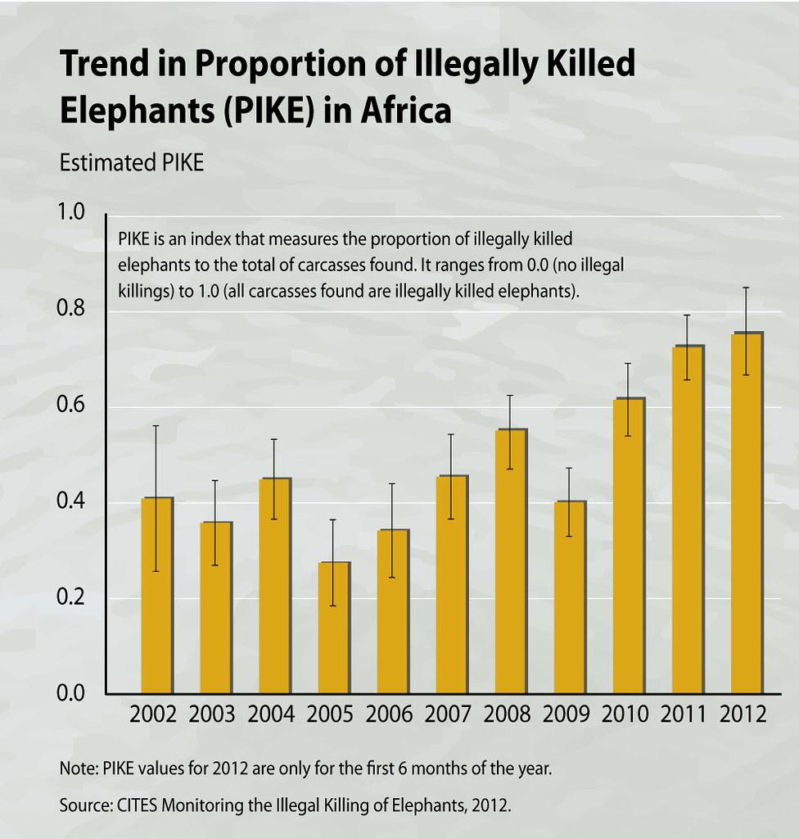
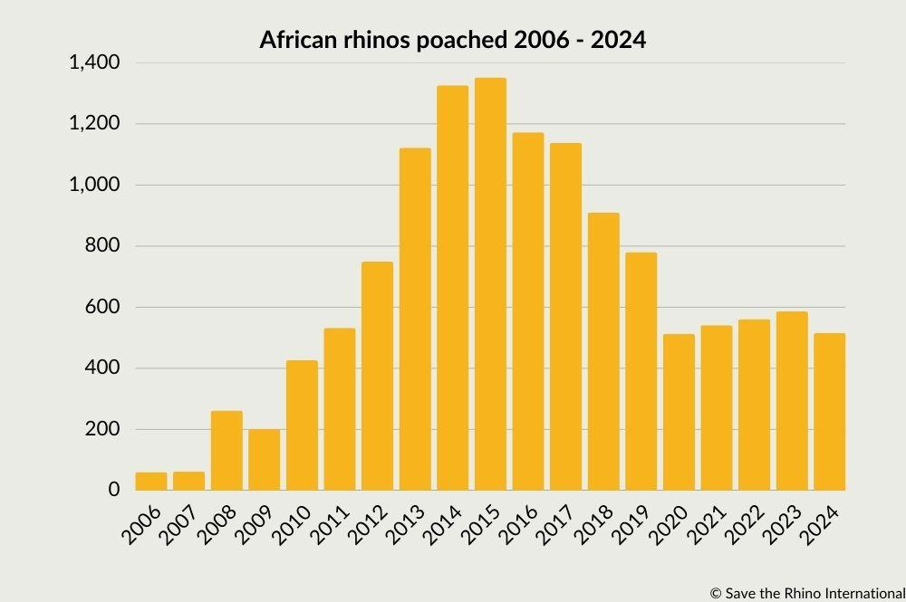
Poaching

Slide 20
Extinction Debt

Slide 21
Extinction Debt
Definition: future or delayed extinction of species caused by environmental disruptions that occurred in the past
Primary Drivers: habitat loss and fragmentation, pollution, or loss of partner species
The Time Lag: the time between habitat damage and species extinction can range from years or decades to even centuries
Conservation Window: extinction debt represents a small window where habitat restoration can prevent species loss
Notes:
Definition the same as on slide
Primary drivers - it is mainly triggered by habitat loss, fragmentation, pollution, or the loss of key partner species (such as pollinators)
Time lag (1) - Animal and plant species rarely disappear immediately when their habitat is destroyed; instead, isolated populations survive for a while in small patches, but face declining breeding rates, higher competition for food, etc. which then lead to extinction
Time lag (2) - time between habitat damge and species extinction can range from years or decades (for insects and birds) to centuries (for long-lived plants/trees)
Conservation window - because affected species still remain alive during this “grace period”, extinction debt represents a window where we still have a chance to restore habitats and prevent species extinction from happening at all

Slide 22
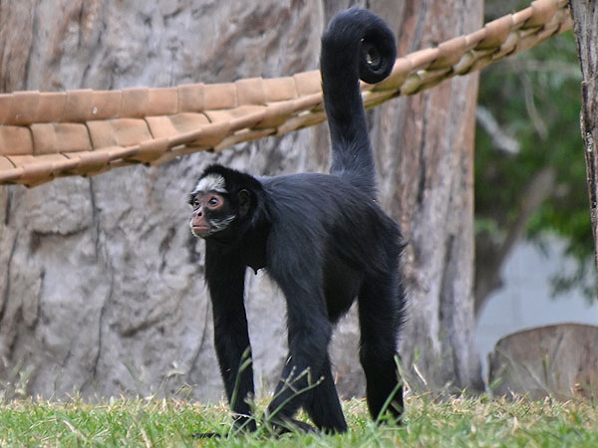
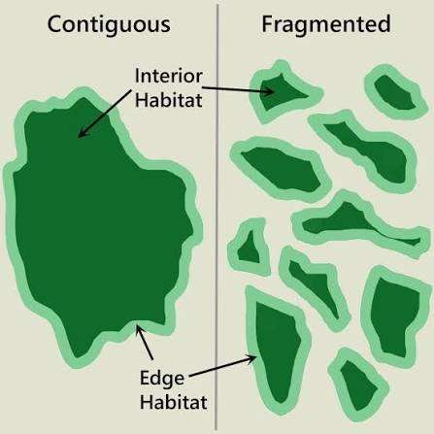
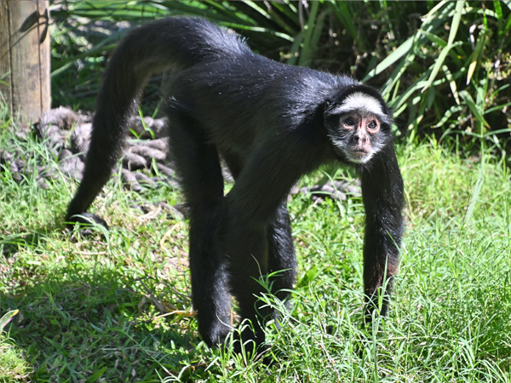
White-Cheeked Spider Monkey (Ateles Marginatus)
Location - Brazilian Amazon
Why is it in extinction debt:
- expansion of farmlands lead to habitat fragmentation
- lowered breeding rates and higher competition for food
(photo link: https://zooinstitutes.com/animals/
white-cheeked-spider-monkey-6200/ )
Notes:
The expansion of farmlands and roadbuilding has fragmented the canopy, isolating populations into smaller forest patches
Because spider monkeys depend on continuous canopy to move, they can’t cross open land.
Although adults survived the initial tree clearing, shrinking territories lower their breeding rates and intensify competition for fruit.
As a result, these isolated groups survive temporarily as the “walking dead” facing extinction as older generations die without being replaced

Slide 23
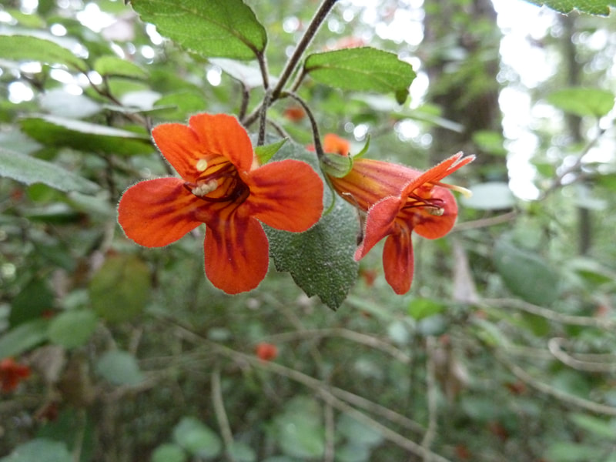
Rhabdothamnus solandri (Taurepo Shrub)
Location - New Zealand
Why is it in extinction debt:
- the shrub relies on native bird pollinators
- several of said pollinators went
locally extinct around 1870
(photo link: Rhabdothamnus solandri - Art and Science of Horticulture)
Notes:
The shrub relies on native pollinating bird species to produce seeds and reproduce.
When several of these key pollinators went locally extinct around 1870, the shrub lost its primary means of reproduction.
Because the Taurepo shrub plants are so long lived, mature individuals have survived over a century without successfully generating new offspring.
The adult plants still stand today, but because reproduction has largely ceased, the species is in extinction debt, which will be collected when the remaining plants reach the end of their lifespan.

Slide 24
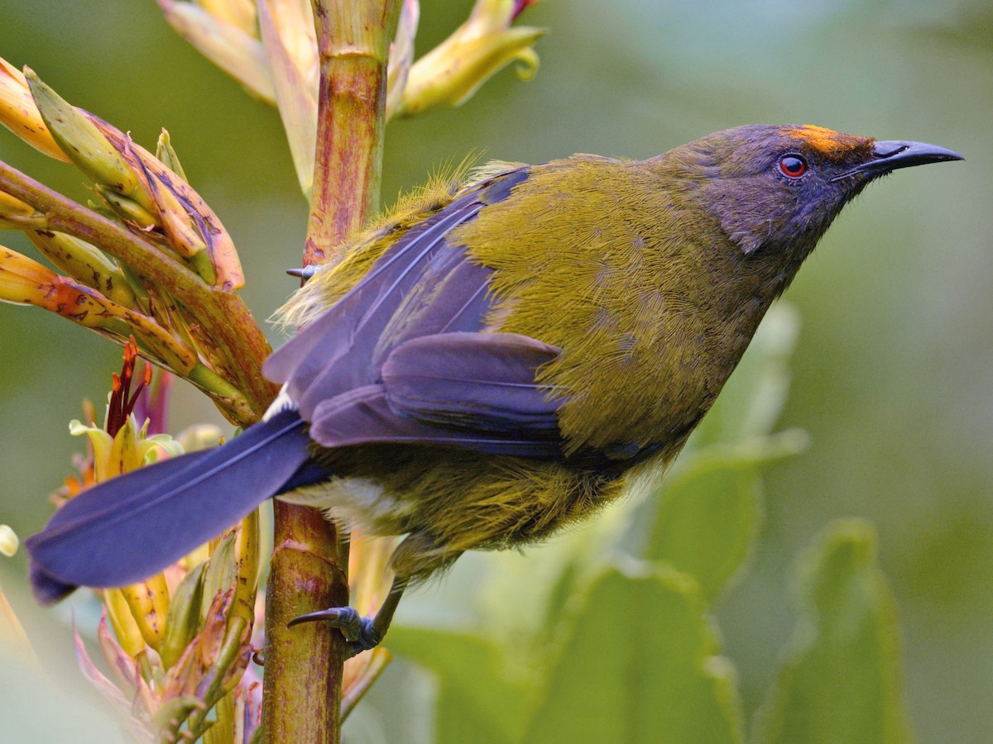
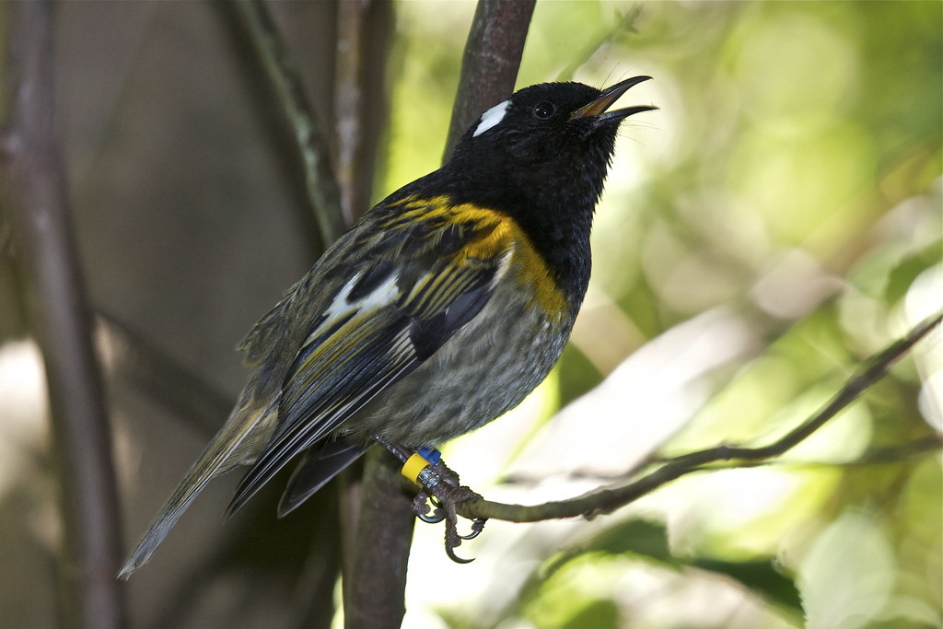
Stitchbird
(Māori: Hihi / Latin: Notiomystis cincta)
Bellbird
(Māori: Korimako / Latin: Anthornis melanura)
Photo links:
Bellbird - New Zealand Bellbird - Anthornis melanura - Birds of the World
Stitchbird - Hihi - stitchbird - Notiomystis cincta | Photographed at Zea… | Flickr
Notes:
Following the introduction of mammalian predators (such as rats and stoats) and clearing of native forests, both the bellbird and stitchbird suffered local extinctions across the North Island mainland around 1870.
While stitchbirds survived on predator-free offshore island sanctuaries (like Hauturu / Little Barrier Island) and bellbirds remained abundant on offshore islands, they vanished from the mainland where the Taurepo shrubs grow.

Slide 25
Conclusions

Slide 26
Reasons FOR the sixth mass extinction | Reasons AGAINST the sixth mass extinction
Modern extinction rate vastly exceeds the background extinction rate | Total species loss remains extremely low
Number of vertebrate species that went extinct in the last 100 years would have taken 800 - 1000 years to go extinct naturally. | Elevated extinction alone do not support a mass extinctions
Severe taxon-wide acceleration in extinction | Historical extinctions are heavily biased towards islands.
Robustness of data | Unrealistic assumptions and omission of invertebrates
Notes:
FOR
Modern is 22 - 53x higher than the background rate and it is 100x higher for amphibians
3) Mammals, fresh water fishes, birds, amphibians and reptiles showed a massive spike in extinction after the 1900s
4) Doubling background rate by only counting species from the IUCN red list and excluding theoretical models gave us BGER double the previous estimate
so that we get the lower bound answer while comparing the BGER to Modern
AGAINST
As mentioned earlier, a mass extinction is the loss of 75% of all species around the world but less than 0.1% have gone extinct.
AND less 0.8% of well assessed land vertebrates have gone extinct which is miles away from the threshold of 75%
3) Wiens counters that roughly 70% of documented extinctions are geographically skewed to highly vulnerable island ecosystems. Because this acceleration is heavily localized rather than continental, he argues it is not the uniform global wipeout required to declare a true mass extinction.
4) non-threatened species which makes up over 50% of accessed species will disappear without a specific cause
and ignores invertebrates and insects which make up 97% of species diversity.
Also ignores successful conservation efforts

Slide 27

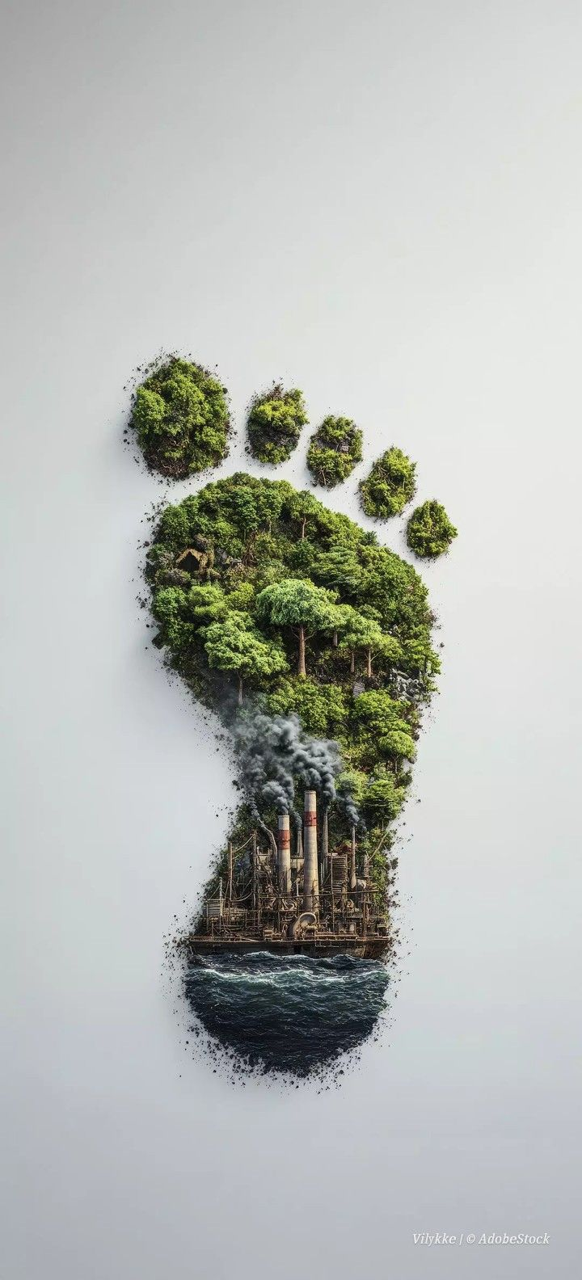

The Warning, The Reality, and The Solution
1. The Verdict: Mass Extinction? | 2. The Driver: Humanity's Impact | 3. The Solution: Conservation
Image Src:Pinterest
Notes:
1. Verdict (Hourglass): Falling sand = Ceballos’s velocity warning. Remaining sand = Wiens’s magnitude (we still have time). The "mass extinction" label is just a distraction from the data.
2. Driver (Footprint): Both papers completely agree on the cause. There is no meteor—the crisis is driven by our land-use, agriculture, and habitat destruction.
3. Solution (Tree): Targeted conservation. Wiens shows extinctions are heavily concentrated in island hotspots, meaning our response can be precise. Humanity’s footprint caused the crisis, but if we act now, our fingerprint is the solution.

Slide 28





Our Group Members
Phone Thant Kyaw
Background vs Contemporary extinction rate
Matyáš Kandl
Extinction debt
Casian Romana
Human impact
João Loureiro
Human Impact
KRIPA THAPA
Big 5,Conclusion

Slide 29
References
https://en.wikipedia.org/wiki/Extinction_event
https://www.iucnredlist.org/
https://www.science.org/
https://onlinelibrary.wiley.com/doi/full/10.1111/gcb.16689https://onlinelibrary.wiley.com/doi/full/10.1111/gcb.16689
https://ourworldindata.org/
https://earth.org/human-activity-land-surface-changes/
https://commons.wikimedia.org/wiki/Main_Page
WWF | (WWF) Endangered Species Conservation
Ceballos, G., Ehrlich, P. R., Barnosky, A. D., García, A., Pringle, R. M., & Palmer, T. M. (2015). Accelerated modern human-induced species losses: Entering the sixth mass extinction. Science Advances, 1(5), e1400253.
Wiens, J. J., & Saban, A. (2025). Questioning the sixth mass extinction. Trends in Ecology & Evolution.

